Slide 1


Cordence Worldwide
An Introduction
2024
Notes:
Opening Slide

Slide 2

The Power of Cordence Worldwide
A constantly changing world means our clients need to be ready to rise to new challenges to stay one step ahead. They require entrepreneurial, connected thinking and agility to help take them further.
Cordence Worldwide is a global network of truly connected consultancy firms with the ability to think and deliver together. We unify independent firms with shared values and diverse specialized experience from across the globe. We combine expert perspectives to create solutions and synergies which lead to real competitive advantage for our clients.
The Power of Cordence… It’s Connected Thinking to help you Get Ahead of What’s Next.

Slide 3
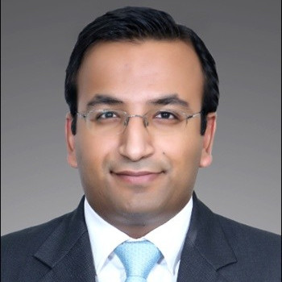
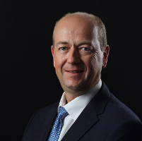
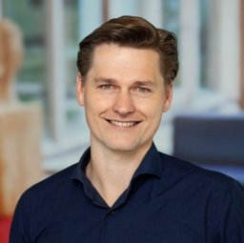


The Power of Cordence Worldwide – What our Consultants say
  “To have at your fingertips a large community around the world of enthusiastic partners who are always willing to step up and offer their support and learnings. Ultimately, it makes us better as consultants when we offer solutions to our clients.” – Shabal Goel – Avalon Consulting, India
  “Cordence was a strong asset to provide a common answer for a large international RFP.” – Benoit Klopocki – Oresys, France
  “Possibility and opportunity to work internationally with other member firms in other countries. This gives a lot of energy and that brings new insights to our clients in the Netherlands.” – Jan Willem de Kleuver – Twynstra Gudde, Netherlands
  “Expand services beyond the Americas. Allows us to showcase the fact that we have sister companies around the world, build awareness and break through the perception of certain clients of us being a North American company only. A lot of our clients have global interests and the fact that we have Cordence as an asset is extremely helpful. The fact that we can help them to get to other countries with some of those initiative and import those initiatives from other countries by leveraging our partners that are in the countries is extremely powerful.” – Todd Nisbet – North Highland, USA

Slide 4









For Clients that need Expertise and Global Reach
We deliver
Connected thinking from our 10 consultancy firms across the Americas, Asia Pacific and Europe, providing an international perspective, exceptional thinking and an open, responsive way of working. We have worked together for more than 18 years.

Slide 5

Who We are – Our Promise
Through our global partnership, Cordence has the global reach and expertise with the ability to think and deliver together. Across the globe, we bring a shared set of values combined with expert perspectives to create solutions and synergies which lead to real value and drive real sustainable change for our clients.
Our Beliefs
Vision, authenticity, bravery, collaboration, inclusivity and entrepreneurship.
Our Behaviors
We are responsive, agile, hard-working, honest – and challenging where we need to be.

Slide 6
Who We are – How we select our partners
Cordence Worldwide members:
Deliver on the promise of global coverage
Bring a common set of capabilities and world-class expertise in consulting (whatever kind they are looking for)
Have expertise in specific industry sectors or functions (again, whatever the client is looking for)
Bring local understanding of culture and language
Have a shared set of values (honesty, transparency, etc.)
Have the resources (number and skills) to be able to provide support.
The Cordence Worldwide partnership has an intake process for potential member companies, evaluating them on their potential to achieve remarkable results, combining global delivery, focused accountability, and an uncommon dedication to clients. Potential candidates for Cordence Worldwide membership must be evaluated on pre-established criteria, which includes: ability to deliver on the promise of global coverage, bringing a common set of capabilities and world-class expertise in consulting, have expertise in specific industry sectors or functions, a local understanding of culture and language, and have the skilled resources to be able to provide support.

Slide 7



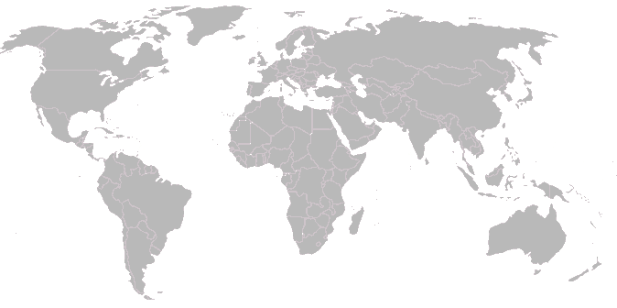


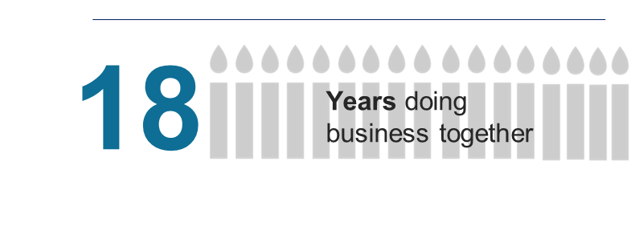
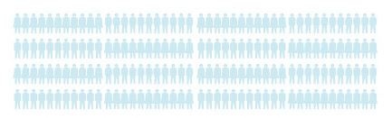
Who We are… Cordence Worldwide by the Numbers
60+
10
Member Firms
Offices around the world
$905M
with total combined
2023 revenues exceeding
in 23 countries
10
Active Communities / Key Topic Groups
5,500+
Automotive
Energy Transition
Industrial Goods
Life Sciences
Transportation
Sustainability & Reporting
AI / Data & Analytics
Public Sector
Healthcare
Retail
Professionals
throughout the world

Slide 8
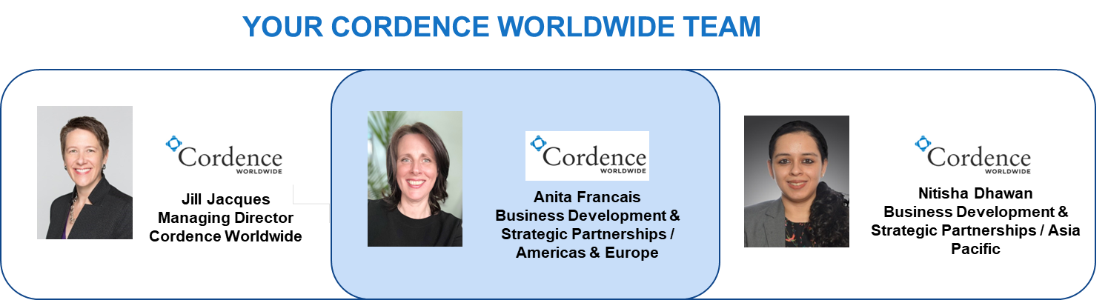
Cordence Worldwide Team

Slide 9


Member Firm Contact Information
INDIA, SINGAPORE
BRAZIL
JAPAN
Avalon Consulting
Phone: (+91) 996 257 7299
Email: Santosh Sreedhar
santosh.sreedhar@consultavalon.com
EloGroup
Phone: (+55) 21 98106-2391
Email: Davi Almeida
davi.almeida@elogroup.com.br
GENEX Partners
Phone: (+81) 3 5795 3211
Email: Taku Oike
oike@genexpartners.com
GERMANY, AUSTRIA, SWITZERLAND, HUNGARY, ROMANIA, ITALY, DENMARK, SAUDI ARABIA, UAE
SOUTH KOREA
UNITED STATES OF AMERICA, UNITED KINGDOM
FRANCE, SWITZERLAND
Horváth & Partners
Phone: (+49) 162 278 6303
Email: Olaf Reichel
oreichel@horvath-partners.com
Key To Way
Phone: (+82) 10 8931 0834
Email: Young Kwon
young.kwon@keytoway.kr
North Highland​
Phone: (+1)
Email: Teri Mendelovitz
Teri.Mendelovitz@northhighland.com
Oresys
Phone: (+33) 680 650 333
Email: Florent Stetten-Pigasse
florent.stetten.pigasse@oresys.eu
2018
MALAYSIA, TANZANIA
AUSTRALIA
THE NETHERLANDS
PEMANDU Associates
Phone: (+41) 78 873 30 94
Email: Jasmin Johnson
jasmin@pemandu.org
State of Matter
Phone: (+61)
Email: Mark Miltenburg
markm@sofm.com.au
Twynstra Gudde
Phone: (+31) 9 6 10 85 32 39
Email: Jan-Willem de Kleuver
jwk@tg.nl

Slide 10
Cordence Worldwide Global Presence
Americas:
USA: Atlanta, Austin, Basking Ridge, Bellevue, Charlotte, Chicago, Denver, Houston, Los Angeles, Nashville, New York, Orlando, Philadelphia, Portland, Seattle, St. Louis, Tallahassee, Washington DC
Canada: Vancouver
Brazil: Rio de Janeiro, São Paulo, Brasília, Belo Horizonte
Asia Pacific:
Australia: Melbourne, Sydney
India: Delhi, Chennai, Mumbai, Bangalore
Japan: Tokyo
Malaysia: Kuala Lumpur
Singapore: Singapore
South Korea: Seoul
EMEA:
Austria: Vienna
Denmark: Copenhagen
France: Lille, Lyon, Marseille, Nantes, Paris, Toulouse
Germany: Berlin, Düsseldorf, Frankfurt, Hamburg, Munich, Stuttgart
Hungary: Budapest
Italy: Milan, Rome
Netherlands: Amersfoort, The Hague
Romania: Bucharest, Cluj
Switzerland: Lausanne, Zurich
Tanzania: Dar es Salaam
UK: London, Manchester
South Africa: Johannesburg
Saudi Arabia: Riyadh
United Arab Emirates: Abu Dhabi, Dubai
10 Partner Firms
60+
Offices in 23 Countries
5,500+
Consultants

Slide 11

Cordence Worldwide Contact Information
Cordence Worldwide – Managing Director
Phone: +1.678.427.4188
Email: Jill Jacques
Jill.Jacques@cordence.com
www.cordence.com

